Slide 1

By Prajakta Babar

Slide 2
Agenda
Version Control Systems
Git History
Why Git?
Getting started
GIT Architecture
Branching and Merging
GIT Workflows

Slide 3
Version Control System
Version control is a system that records changes to a file or set of files over time so that you can recall specific versions later.
If you screw things up or lose files, you can easily recover.
Almost all “real” projects use some kind of version control
Any company with a clue uses some kind of version control
Companies without a clue are bad places to work!!!

Slide 4
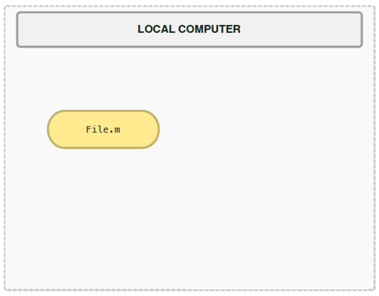
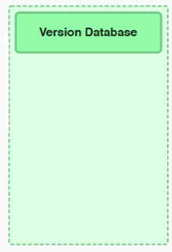



Centralized Version Control Systems
These systems think of the information they keep as a set of files and the changes made to each file over time.
Single server that contains all the version files, and a number of clients that check out files from that central place.
Example
- CVS
- Subversion
- Visual Source Safe

Slide 5
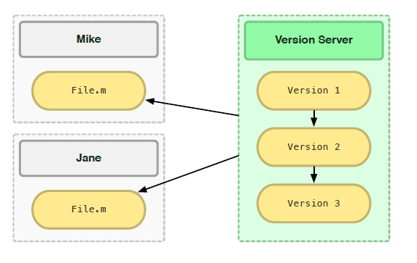
Problems faced in CVCS
Single point of failure
Dependent on access to the server
Hard to manage a server and backups
It can be slower because every command connects to the server.
Branching and merging tools are difficult to use.
Multi-developer conflicts

Slide 6
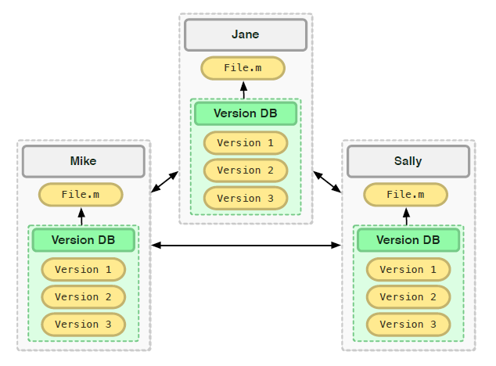
Distributed Version Control Systems
Every checkout is really a full backup of all the data.
Allows you to set up several types of workflows that aren’t possible in centralized systems
Other distributed systems include
- Mercurial
- BitKeeper
- Darcs
- Bazaar

Slide 7
DVCS Advantages
Every clone is a backup.
It works offline.
It’s fast.
It handles changes well.
Branching and merging is easy.
Less management.

Slide 8
Everything is Local (Almost)
One huge benefit is that almost all version control operations happen locally.
Aside from sync, and then only if sync is not between two local repositories.
Create Repo | Rebase | Diff
Commit | Tag | History
Merge | Status | Bisect
Branch | Revision | Local Sync

Slide 9
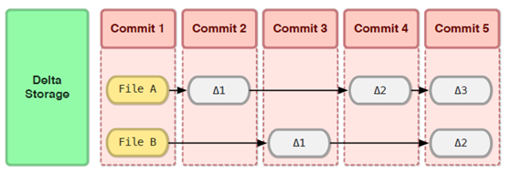
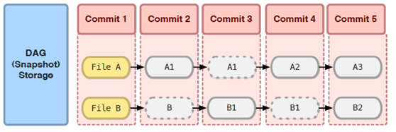
Storage
There are two ways VCS store their data
Delta Storage: store data as changes to a base version of each file.
Snapshot Storage (a.k.a. Direct Acyclic Graph): Each commit takes a full snapshot of your entire working directory.

Slide 10
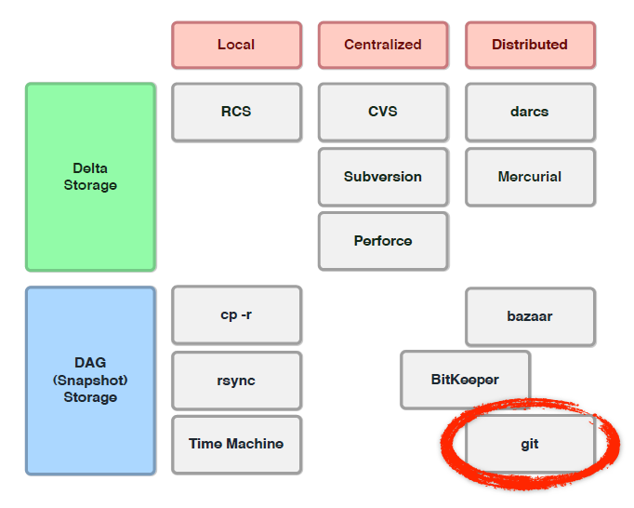
Delta vs. Snapshot
Git is a distributed VCS that uses the snapshot storage model.

Slide 11



History of GIT
1991–2002
The Linux kernel maintenance, changes to the software were passed around as patches and archived files.
2002-2005
Began using a proprietary DVCS system called BitKeeper.
Relationship between the Linux kernel and BitKeeper broke down
2005
Prompted the Linux development community (and Linus Torvalds) to develop their own tool
Based on lessons learned while using BitKeeper

Slide 12
Why GIT?
Free and Open Source
Simple design
Excellent Branching and Merging
Fully distributed
Handles large projects efficiently
GIT
High Speed
Strong support for non-linear development

Slide 13
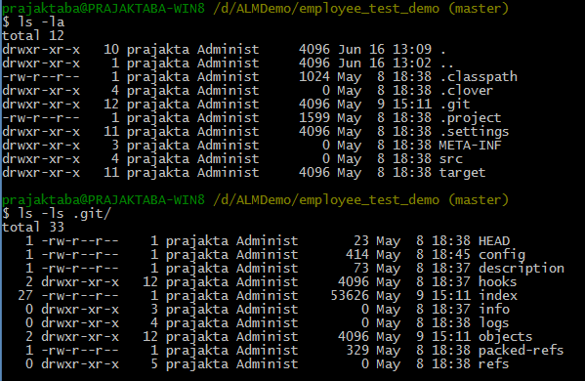
Git Directory
.git only in root of Working Directory(unlike Subversion)

Slide 14
Getting Started
Git Directory
Staging Area
Working Directory
This leads us to the three main sections of a Git project
Git Directory: is where Git stores the metadata and object database for your project.
Checkout the Project
Staging Area: stores information about what will go into your next commit. Also called ‘Index’.
Stage Files
Working directory: is a single checkout of one version of the project
Commit

Slide 15
Basic Workflow
Git Repository
Fetch
Push
Init or Clone
a repo
Local Repository
Checkout Head
Commit
Staging Area
Stage the
changes
Working Folder

Slide 16
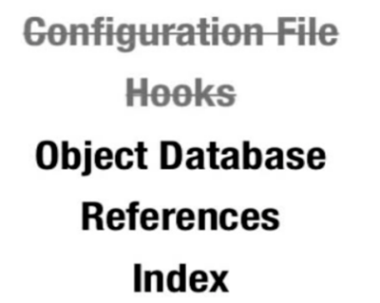
Git Directory

Slide 17
Git Branching and Merging Features
Some people refer to the branching model in Git as its “killer feature”
Lightweight
Nearly instantaneous
Switching back and forth between branches generally just as fast
Git encourages a workflow that branches and merges often
Non-linear development(Parallelize)
Easy to handle Long Running Topics
Isolate Experiments
Hot Fix

Slide 18
Git Workflows
Git workflows are designed to be guidelines rather than concrete rules.
You can mix and match aspects from different workflows to suit your individual needs.
Major workflows are
Centralized Workflow
Feature Branch Workflow
Gitflow Workflow
Forking Workflow

Slide 19
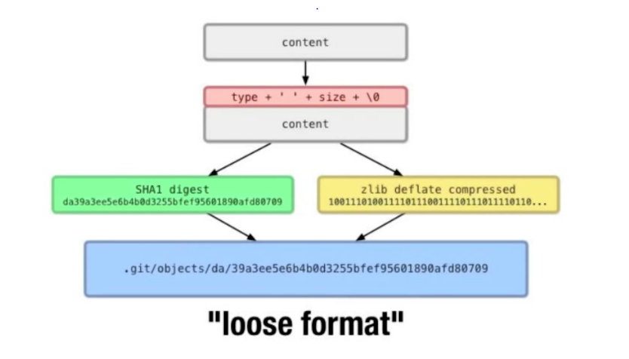
Object database

Slide 20
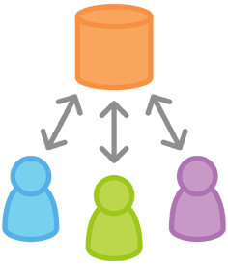
Centralized Workflow
Your team can develop projects in the exact same way as they do with Subversion.
Gives every developer their own local copy of the entire project.
Gives you access to Git’s robust branching and merging model.
Comfort of Subversion, advantages of Git!!!

Slide 21
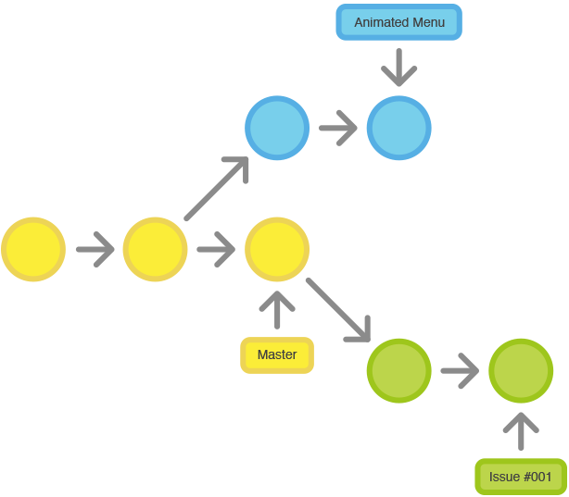
Feature Branch Workflow
To encourage collaboration and streamline communication between developers.
All feature development should take place in a dedicated branch instead of the master branch.
Easy for multiple developers to work on a particular feature without disturbing the main codebase
The master branch will never contain broken code, which is a huge advantage for continuous integration environments.

Slide 22
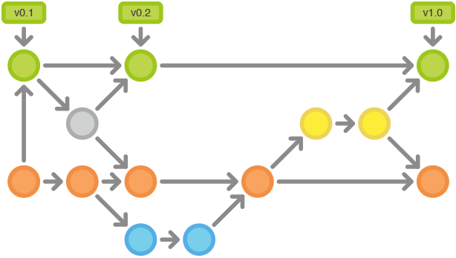
Gitflow Workflow
Defines a strict branching model designed around the project release.
Provides a robust framework for managing larger projects.
Assigns very specific roles to different branches and defines how and when they should interact.
Uses individual branches for preparing, maintaining, and recording releases.

Slide 23
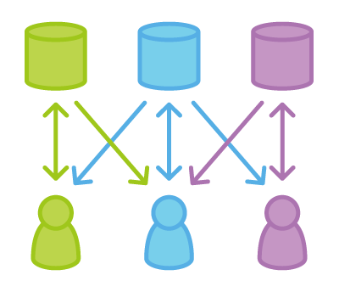
Forking Workflow
Fundamentally different than the other workflows
Gives every developer a server-side repository
Each contributor has two Git repositories: a private local and a public server-side
The result is a distributed workflow that provides a flexible way for large, organic teams (including untrusted third-parties) to collaborate securely.
This also makes it an ideal workflow for open source projects.

Slide 24

Any Questions?

Slide 25
Thank You!

